Slide 1
Iot workshop- baby safety system
​
Nimrod Kaplan
Ofek Tikotzky
Nitzan Kiosso

Slide 2

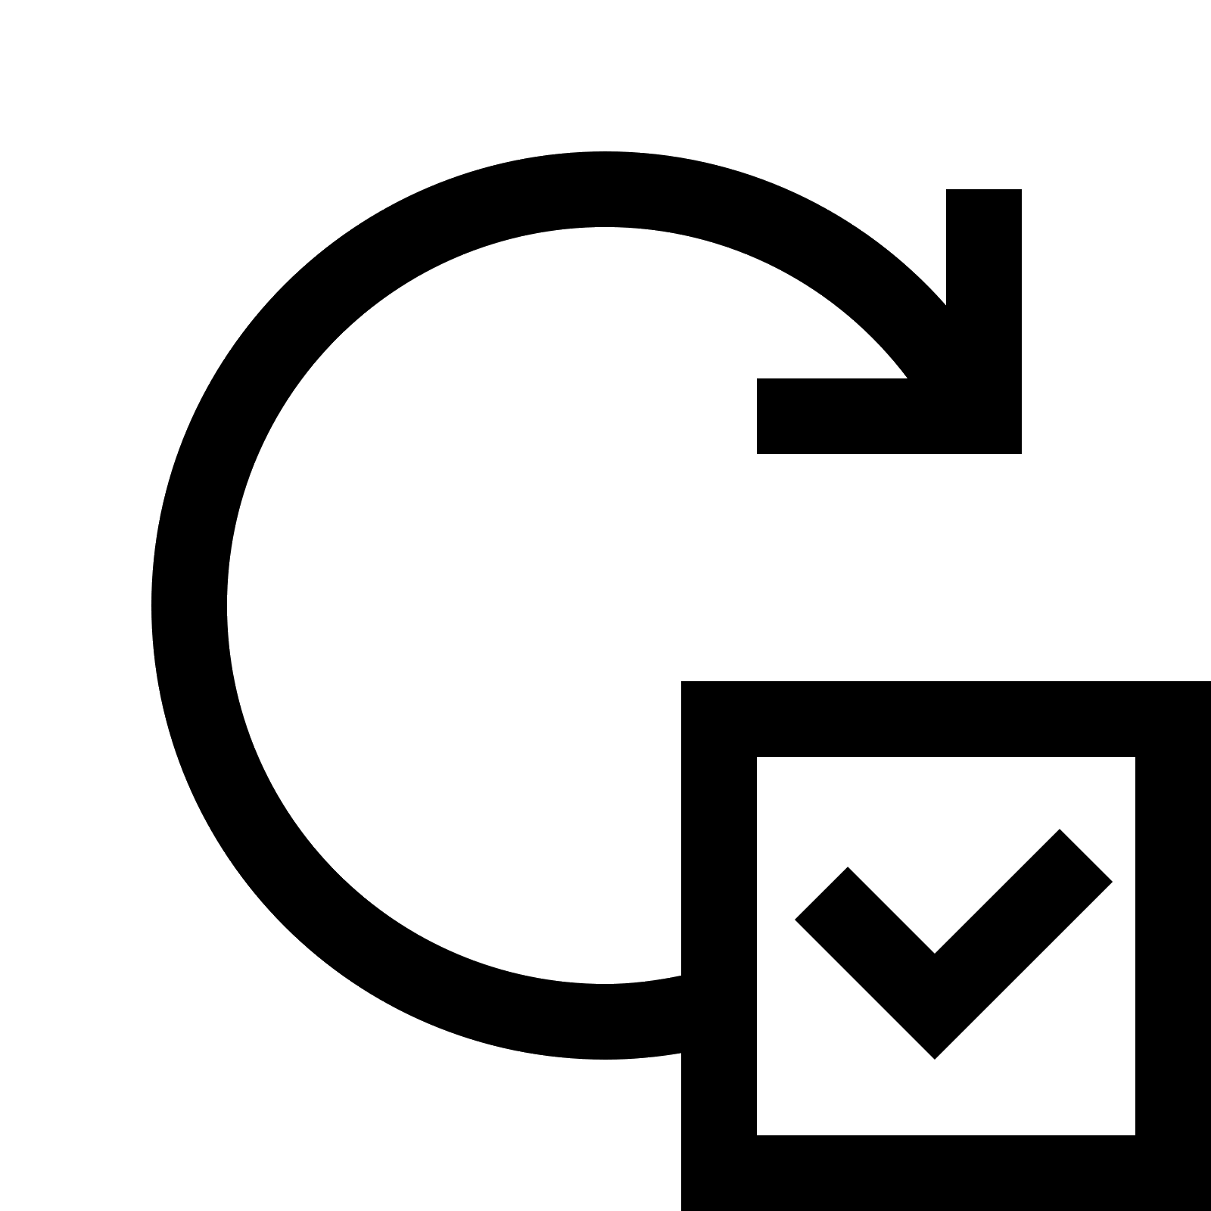

Our project is a command and control system for parents to:
monitoring
Live updates
administration
Track their baby’s and environment conditions.
Alert parents if their baby is left unattended, or in dangerous conditions.
Manage families and babies

Slide 3
System overview
Iot device
Mobile app
Web app
Azure storage
Azure functions & signalr
The “babytag” - an ESP32 embedded bracelet, connected to Wi-Fi and BLE
A Mobile app to monitor children, add new devices, and manage the device’ Wi-Fi connection.
Web app stored in Azure, offers admin and user pages
Storage tables to store baby’s information.
Azure resources used in the project

Slide 4
Main features and user flows
Administration
Adding Babytags using QR code
Monitoring babies
Web app for administration
To get tag UUID
Sampling nearby babytag using BLE
Managing device wifi connection
Using mobile app
Viewing babytags in a single family
Viewing all families and babytags

Slide 5
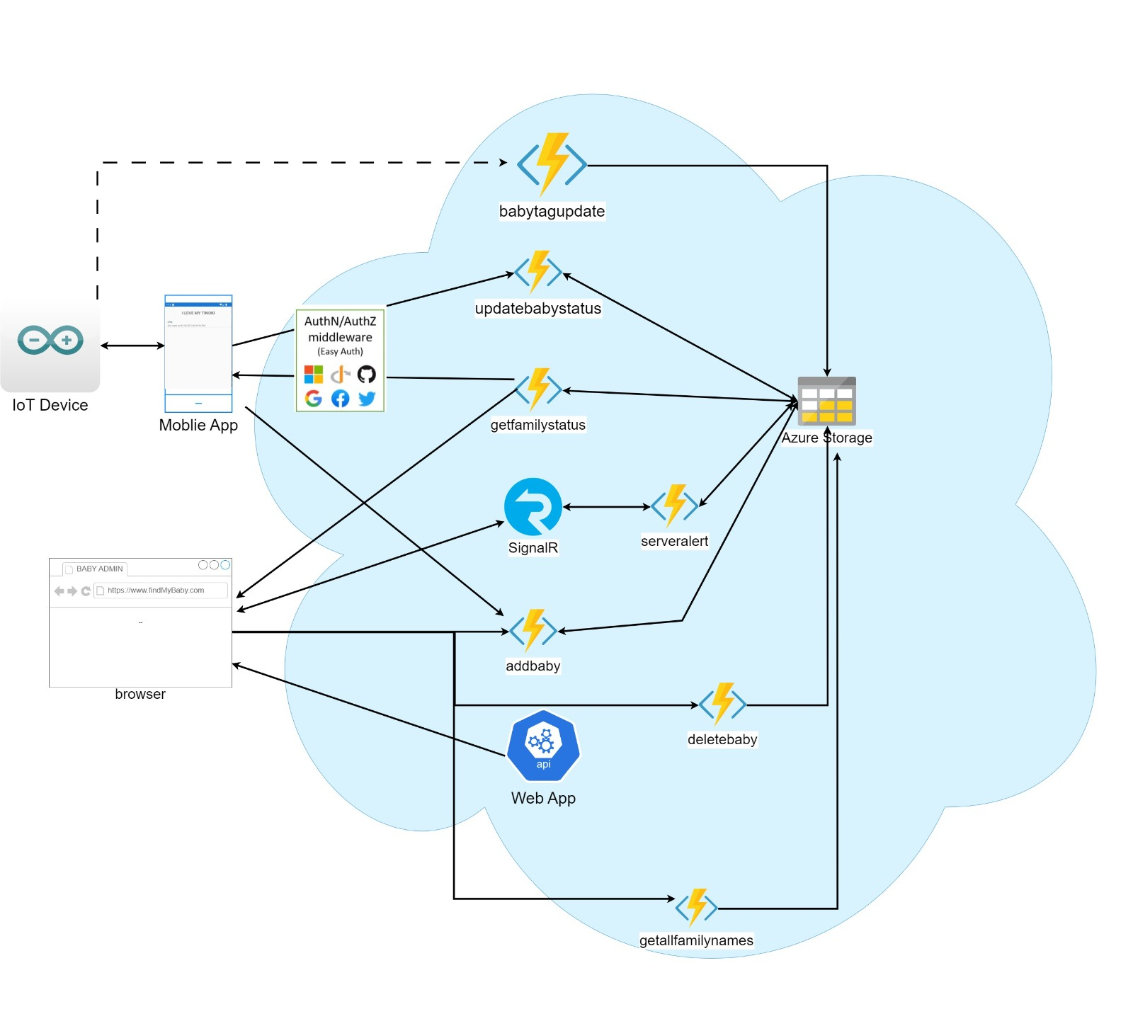
Overall architecture

Slide 6
Azure functions and storage
User functions
Add baby
Admin functions
Add baby
Babytag functions
Babytag update
Update baby status
Get family status
Delete baby
Get family status
Get all families

Slide 7
Azure functions - security
Authentication to function app
Easy-auth using Azure AD users
Getting family name from “x-ms-token-aad-id-token” request header (JWT added by the identity provider)
Strict Input validation on server side
API keys to administration functions

Slide 8
Iot device - babytag
The IoT Device serves as a BLE server while also offering connectivity through Wi-Fi to the internet.
Two modes: Wi-Fi On/Off.
Wi-Fi Off:
BLE service with unique UUID
Two BLE characteristics: temperature and humidity
Wi-Fi On (Given credentials): All the above, plus:
Publish to Azure Services (HTTPS)

Slide 9
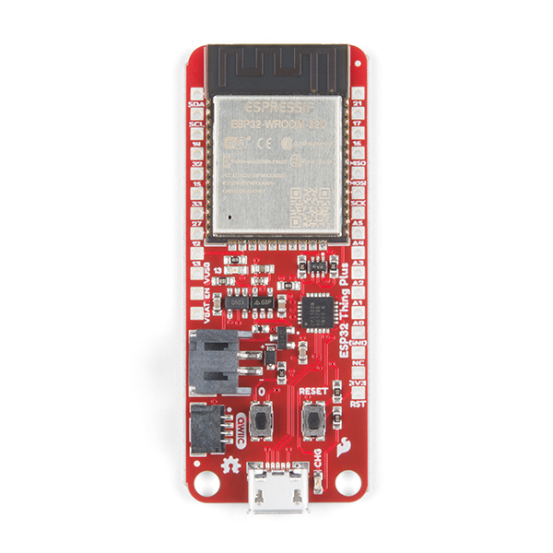
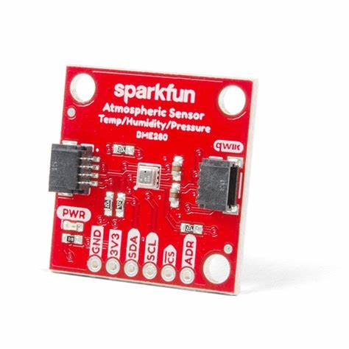
Iot device - Hardware
Sparkfun ESP32 Thing plus
Functionality in use:
BLE – Communication with the Mobile app.
Wifi – Communication with Azure services.
True random generator – Security.
QWIIC: Connected to Sparkfun BME280 Sensor – Sampling environmental data.

Slide 10
Iot device – Software
Setup:
Developed using Arduino IDE
Board support: ESP32 (SparkFun ESP32 Thing Plus)
Libraries:
SparkFunBME280
AESLib
WiFiClientSecure
BLEDevice
HTTPClient

Slide 11
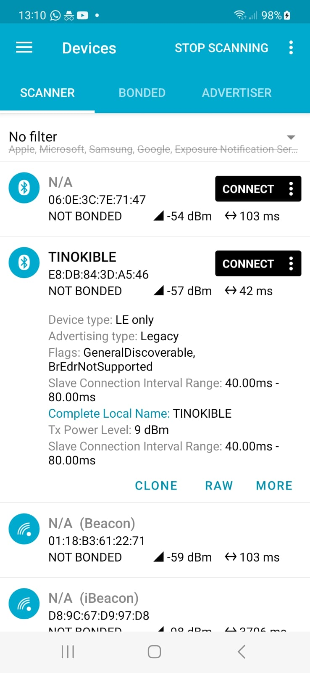
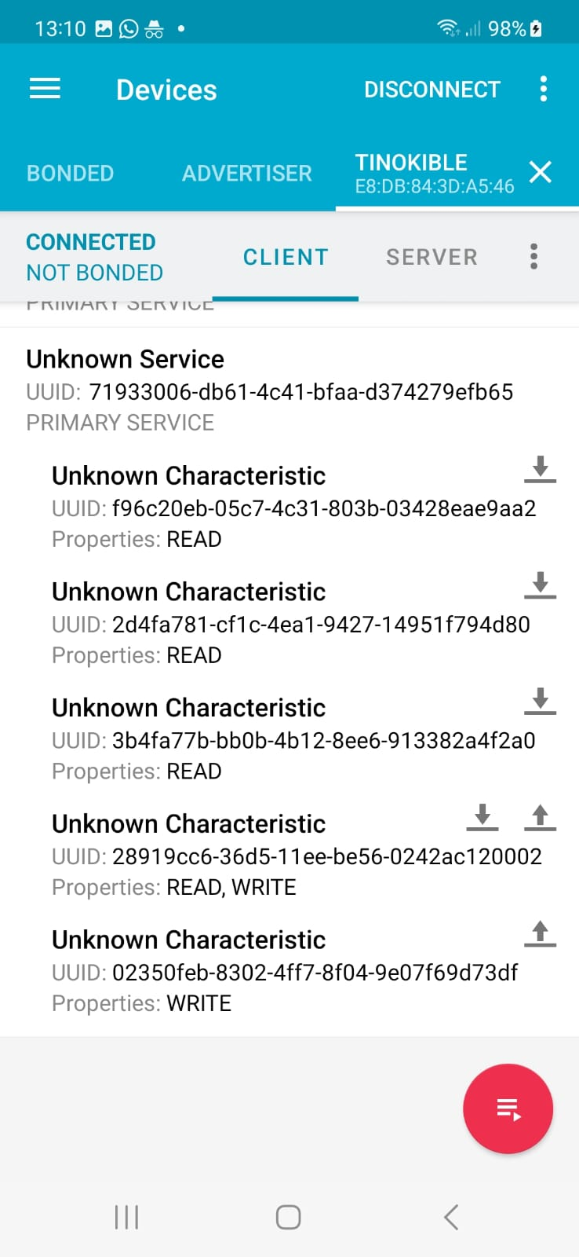
Iot device – Software
BLE Server points:
Data points:
Temperature(R)\Humidity(R)
Communication\Security points:
SSID(RW)\Password(W)\Sync(R)

Slide 12
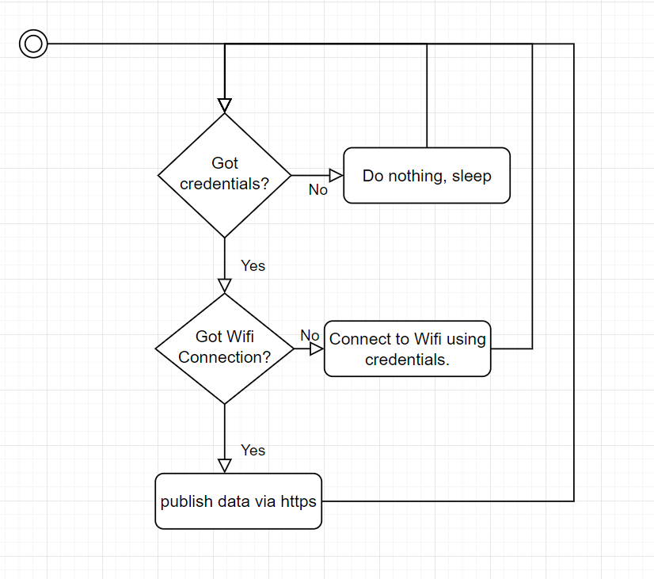
Iot device – Software
Main loop:

Slide 13
IOT DEVice – CONNect to Wifi
Connecting the IoT device to Wifi is according to this flow:
Setting Wifi credentials + Scanning QR Code (Gaining AESKey) triggers the following sequence:
Checking if IoT device is connected to Wifi (using BLE point)
Getting Sync from IoT device
Encrypting password
Sending encrypted password + plaintext SSID to IoT device
Decrypting received password + setting SSID
Generating new Sync for AES128
Connecting to Wifi
If connected successfully, sets BLE point to SSID value

Slide 14
Mobile app – main features
Baby monitoring
Show status of all babies in family
Add baby
Display further details
Manage babytag wifi connection
Get babytag UUID using QR code
Authentication
Alerts Via SignalR

Slide 15
Mobile app – authentication
Microsoft azure Mobileserviceclient library
Android service to manage authenticated http client.
Adding authentication token to all requests in X-ZUMO-AUTH header.

Slide 16
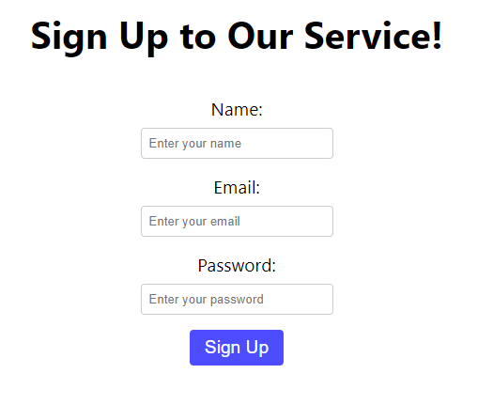
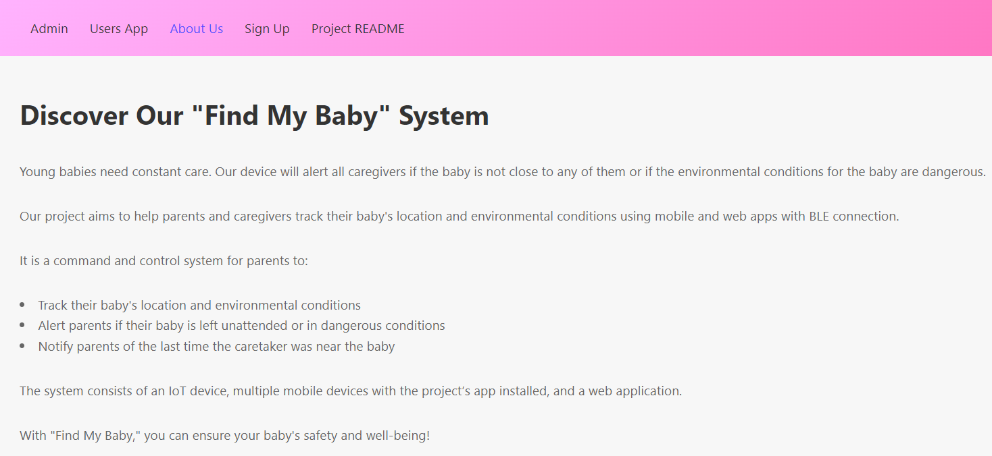
Web app
The web app has been created using the React framework with the Axios library. It is multi-page.
1. Admin
2. User
3. About- A page that presents the project and our vision.
4. Sign Up- visitors can leave contact information and sign up to our service.
Azure services:
the web app accesses the Azure storage tables to update and extract information.
it uses Azure function apps and signalR.
we also use Microsoft Azure authentication to allow different permissions for different people.
Link- https://basicreactapp.azurewebsites.net/

Slide 17
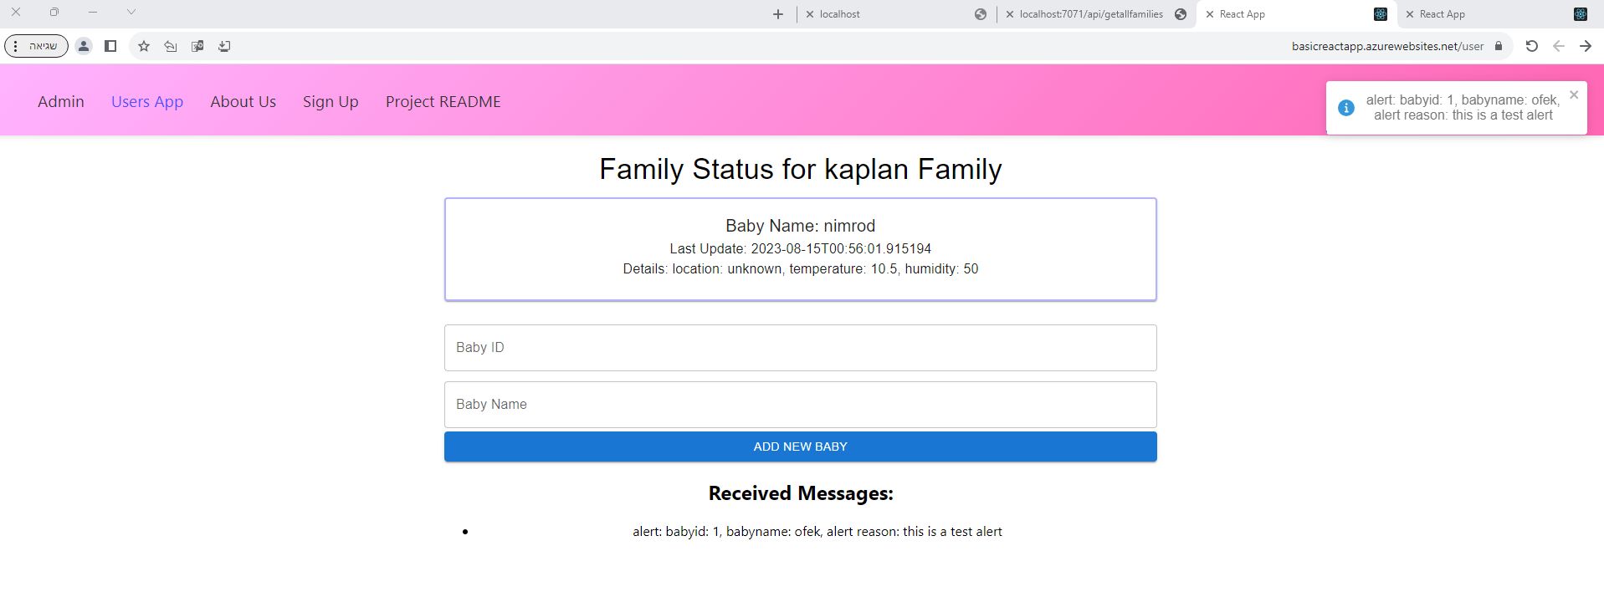
Web app - user page
The User page is designed for individual families within the system.
They can see their family’s information, add new babies and see pop up updates through SignalR.

Slide 18
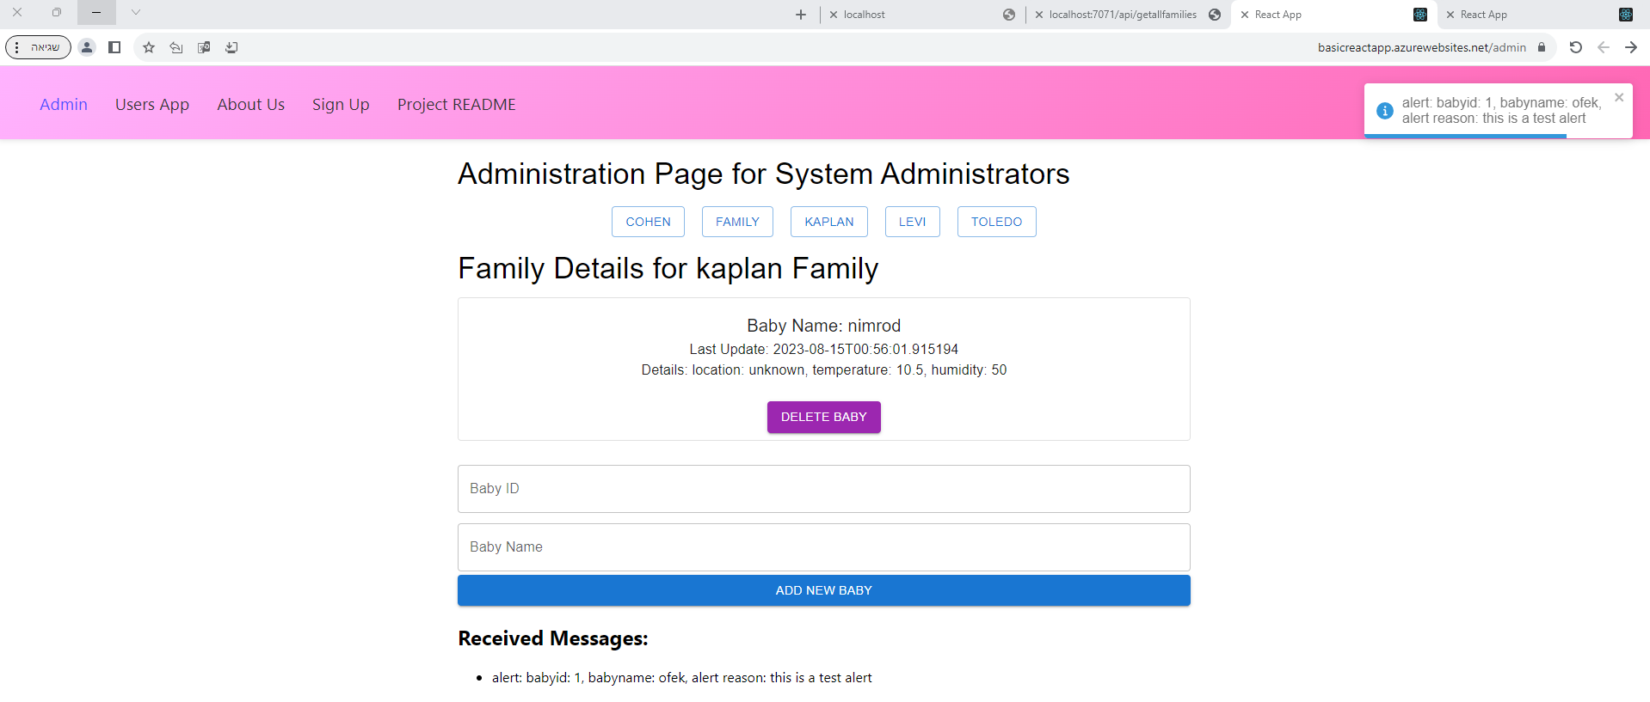
Web app- admin page
The Admin page stands as a control center, for system managers.
Admins can monitor all families, add baby, delete baby and receive real-time SignalR alerts. All changes are updated in the DB, and therefore in the mobile app and the user page.

Slide 19
LIVE DEMO

Slide 20
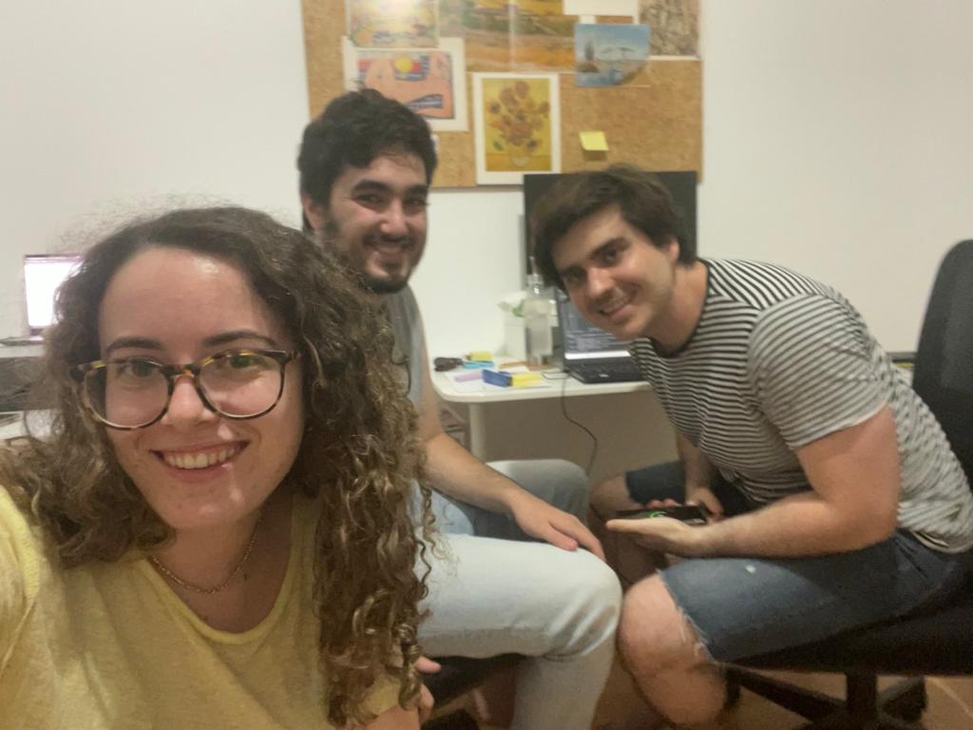
THANK YOU

